Slide 1

IBM Watson-Powered
College Helpdesk Chatbot

Slide 2


Manual helpdesk can't keep up with repetitive student queries
Repeated queries drain staff time
After-hours vacuum
Admission, fees, timetable, exams, placements — same questions asked hundreds of times daily.
Helpdesk works 10am–4pm. Students need answers at night, weekends, during form deadlines.
Slow response = poor experience
Staff burden & errors
Queues, delayed emails, phone not reachable — leads to frustration and misinformation.
Manual copy-paste answers increase mistakes and leave no analytics on what students actually need.

Slide 3








College Helpdesk Bot
LIVE ON IBM
Build a 24x7 AI assistant that answers instantly
CSE ka fees kitna hai?
B.Tech CSE fees is ₹89,000/year. Scholarship up to 30% based on merit. Want hostel details too?
Provide instant answers to common queries — admission, fees, exam, placement, hostel.
Timetable for 5th sem?
Reduce manual workload by automating 80% repetitive questions for staff.
5th Sem CSE: Mon-Fri 9am-4pm — DM, CN, AI labs. PDF sent.
Deploy on IBM Cloud and embed on college website with chat widget.
Improve student experience with analytics on real queries and gaps.
<2s
24x7
₹0
AVG RESPONSE
AVAILABILITY
LITE COST

Slide 4










What is IBM Watson Assistant?
IBM's enterprise conversational AI — understands natural language without heavy coding. You train it like a brain, not program it like an app.
Natural Language Understanding
Intents + Entities
Drag-and-drop dialog
Built for IBM Cloud
#fees_query detects goal, @department (CSE, ECE, ME) extracts context. Builds accurate answers.
Visual flow builder creates responses, buttons, and API calls — no Python needed for basic bot.
Lite plan free, embed script for website, API ready for WhatsApp, mobile app, Facebook.
Understands intent in Hinglish, typos, variations — “fees kitna hai”, “fee structure btao” → same intent.

Slide 5


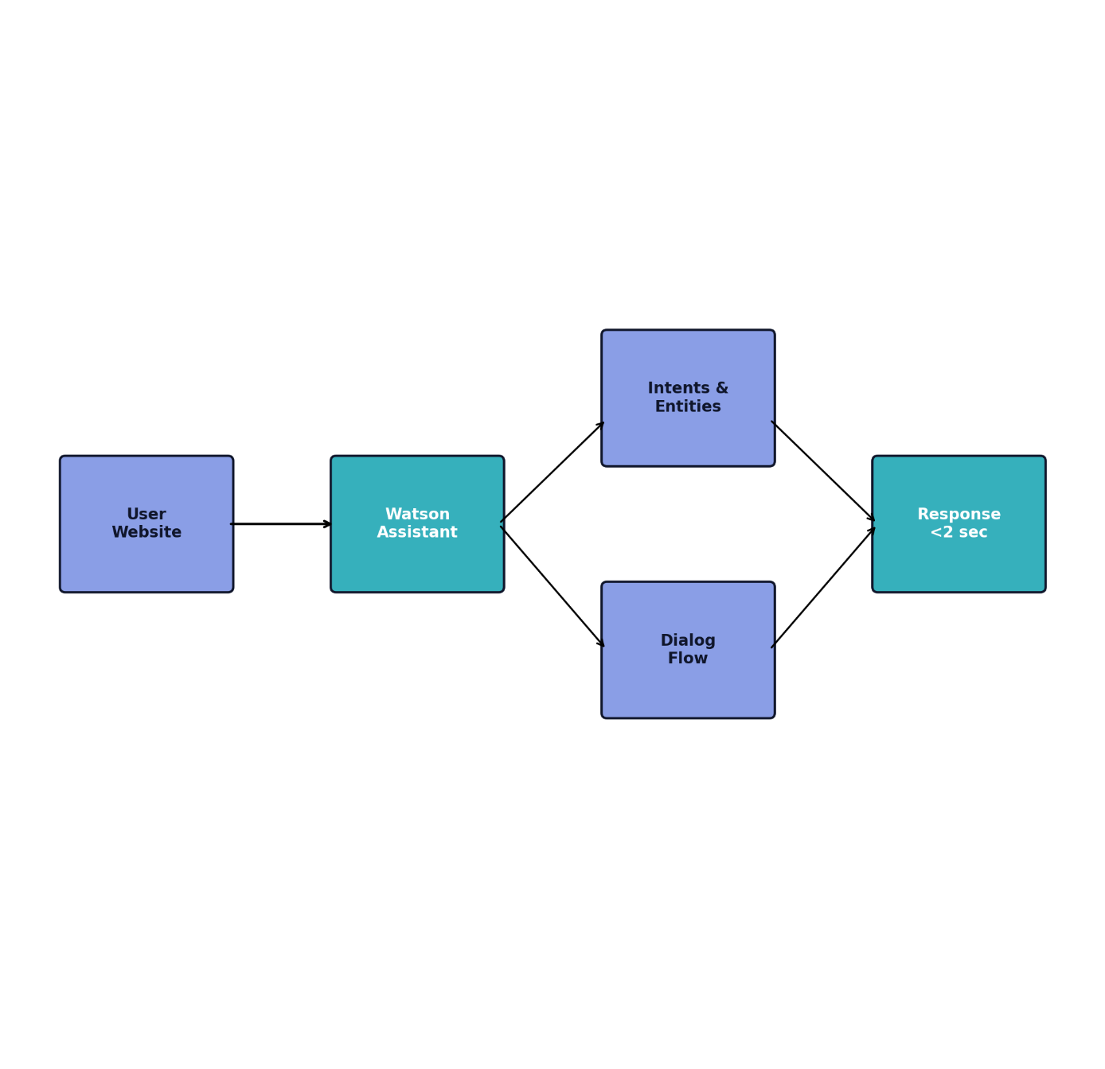





SYSTEM FLOW — <2 SEC LATENCY
System architecture built on Watson cloud
01
User → Website widget
Student types query in embedded chat. Widget sends text to IBM Cloud securely via API.
02
Watson NLU → Intents & Entities
Detects intent like #fees_query and entity @department = CSE using natural language understanding.
03
Dialog engine → Response
Dialog node matches condition, fetches answer from knowledge base or Cloudant.
04
Instant reply to user
Returns formatted answer in <2 seconds, logs analytics for improvement.

Slide 6





One bot covers the full student lifecycle
INTENT #ADMISSION_QUERY
Admission & eligibility
Fees & scholarship
Process, cut-off, documents, important dates and contact for queries.
Branch-wise fees, payment link, scholarship criteria and deadlines.
Academics
Campus info
Timetable, exam schedule, results, syllabus — by @semester and @department.
Departments, faculty, labs, library hours, hostel fees and facilities.
Placement & support — 24x7, Hinglish ready
Placement stats, internship drives, company list. Bot works day-night, answers in English + Hindi mix like “CSE ka fees kitna hai?”

Slide 7



Implementation in 5 clear moves on IBM Cloud
1
Create IBM Cloud Lite account & Watson Assistant service
Sign up free at cloud.ibm.com → Catalog → Watson Assistant → Create (Dallas region, Lite plan).
2 MINS SETUP
2
Create Assistant + Add Actions
Launch Watson → New Assistant → Name: College Helpdesk Bot → Create custom actions for each query type.
Zero heavy coding. Everything built in Watson Assistant UI with drag-drop actions and preview testing.
3
Define 30+ Intents, Entities, Dialog flow
Ex: #fees_query, #timetable + @department {CSE, ECE}. Build branching dialog with responses.
4
Test in Preview panel
Type "CSE ka fees kitna hai?" → Verify intent detection & entity mapping, refine training phrases.
5
Deploy via Web Chat embed & monitor
Integrations → Webchat → Copy script → Paste in college website footer. Check Analytics dashboard.

Slide 8






















Intents and entities trained for college language
30+
12
<2s
Example: "CSE ka fees kitna hai?"
maps to #fees_query + @department:CSE
INTENTS DEFINED
ENTITIES + SYNONYMS
NLU RESOLUTION
Top intents
Key entities & values
#greeting
#admission_query
#fees_query
#scholarship
#timetable
@department: CSE, ECE, ME, Civil, AI/ML
@semester: 1st to 8th
#exam_dates
#results
#placement
#hostel
#library
#faculty
@course: B.Tech, M.Tech, MBA
@fee_type: tuition, hostel, exam
#goodbye
@query_type: eligibility, process, documents
Training approach: 15-20 user examples per intent, Hindi + Hinglish + English variations, negative examples to avoid confusion.
Dialog skill: Slot-filling — if department missing, bot asks "Kaunse department ki baat kar rahe ho?"
LIVE UNDERSTANDING
User: "5th sem ka exam kab hai?"
→ Intent: #exam_dates → Entity: @semester=5th

Slide 9









Zero-cost to build, enterprise-grade to scale
TRADITIONAL HELPDESK
WATSON COLLEGE BOT — BENEFITS
10am–4pm only, queues, phone not reachable during admissions
₹0 with Lite plan — no Python coding needed, drag-drop dialog builder
Staff answers same 200+ queries daily, no tracking, copy-paste errors
Fast & accurate 24x7 — <2s reply, handles Hinglish: "CSE ka fees kitna hai?"
Scalable everywhere — same brain on website, WhatsApp, Facebook, mobile app
Needs separate team for website, WhatsApp, app — costly
Analytics dashboard — see top queries, unanswered questions, improve bot weekly
IBM CLOUD LITE FREE
NO HEAVY CODING
SCALABLE API

Slide 10









Voice assistant integration
Add Watson STT + TTS so students can speak queries in Hindi/English on website kiosk.
NEXT VERSION
From chat widget to campus brain
Connect to College ERP & Cloudant DB
Fetch real-time timetable, fees due, results directly instead of static answers.
Full Hindi + Hinglish support
Current bot answers FAQs. Future roadmap connects it to live college systems and voice channels for zero-friction help.
Train intents with Devanagari and transliteration for inclusive access.
AI document verification
Upload marksheets, bot uses Watson Discovery to check eligibility before admission guidance.
5×
Live
CHANNELS
ERP LINKED
WhatsApp via Cloud Functions
Deploy same assistant on WhatsApp using IBM Cloud Functions webhook — no new training.

Slide 11


Successfully built a cost-effective, scalable college helpdesk
Easy to build, zero code
24x7 student satisfaction
Ready for production
Watson Assistant Lite, 30+ intents, drag-drop dialog — built in 2 days, no heavy Python.
Instant <2s answers for admission, fees, exams, placement. Available after college hours.
Embed script ready for college site, analytics to track queries, scalable to WhatsApp.
THANK YOU
IBM Watson College Helpdesk Chatbot — Project ready for live deployment

Slide 12

LINK : https://gniot-sanskar.github.io/gniot-chatbot-demo/

